Slide 1

Neural Networks and Deep Learning Perceptron
Presented by
Dr. T. Hitendra Sarma
Associate Professor
Department of Information Technology
Vasavi College of Engineering, Hyderabad

Slide 2

The Perceptron Algorithm
The slides are mainly from Vivek Srikumar
1

Slide 3
Outline
The Perceptron Algorithm & Convergence
3

Slide 4
Recall: Linear Classifiers
Input is a n dimensional vector x
Output is a label y ∈ {-1, 1}
Linear Threshold Units (LTUs) classify an example x using the following classification rule
Output = sgn(w^{T}x + b) = sgn(b +∑w_{i} x_{i})
w^{T}x + b ≥ 0 → Predict y = 1
w^{T}x + b < 0 → Predict y = -1
b is called the bias term
4

Slide 5








Recall: Linear Classifiers
Input is a n dimensional vector x
Output is a label y ∈ {-1, 1}
Linear Threshold Units (LTUs) classify an example x using the following classification rule
sgn
∑
– Output = sgn(w^{T}x + b) = sgn(b +∑w_{i} x_{i})
– w^{T}x + b ¸ 0 ) Predict y = 1
– w^{T}x + b < 0 ) Predict y = -1
b is called the bias term
𝑤₁ 𝑤₍ 𝑤₎ 𝑤*
𝑥₁ 𝑥₍ 𝑥₎ 𝑥*
𝑤₊ 𝑤₆ 𝑤₇
𝑥₊ 𝑥₆ 𝑥₇
𝑤₈ 𝑏
𝑥₈ 1
5

Slide 6



The geometry of a linear classifier
sgn(b +w₁ x₁ + w₂x₂)
b +w₁ x₁ + w₂x₂=0
We only care about the sign, not the magnitude
+ +₊+₊
+ +
+
[w₁ w₂]
x₁
- -
₋₋ - ₋-⁻ -
In n dimensions, a linear classifier
represents a hyperplane that separates the space into two half-spaces
--₋₋ -
- ₋ ₋
x₂
6

Slide 7
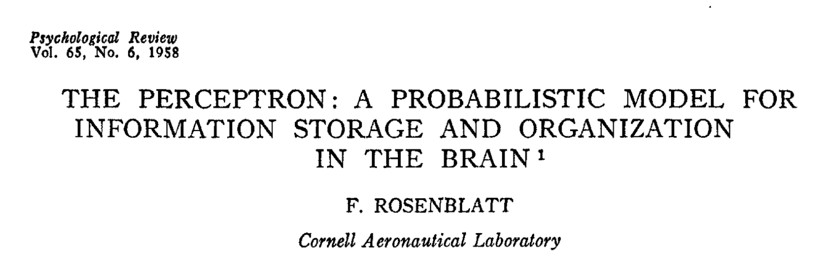
The Perceptron
7

Slide 8
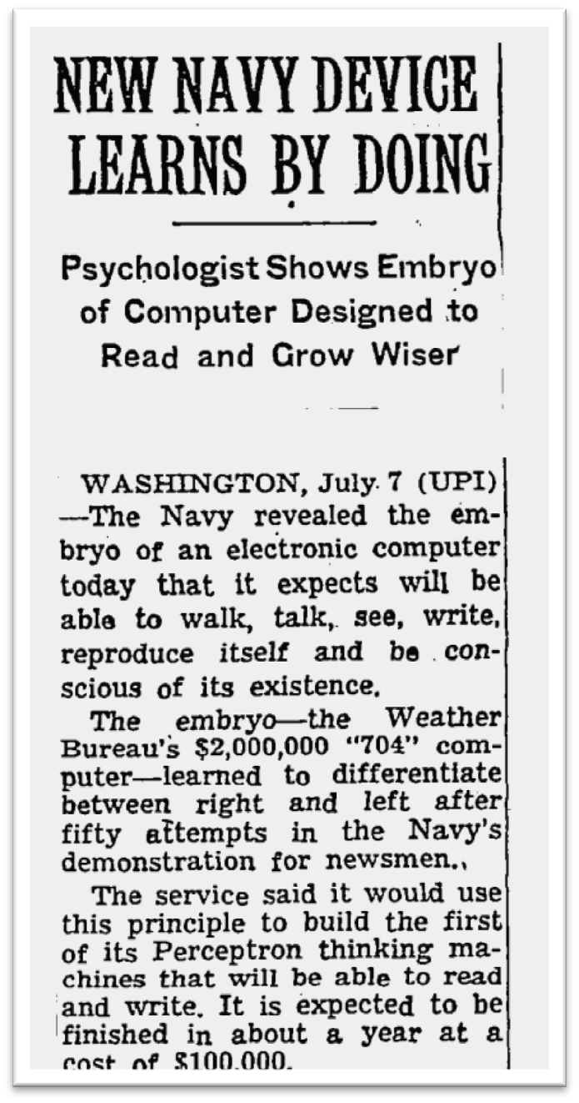
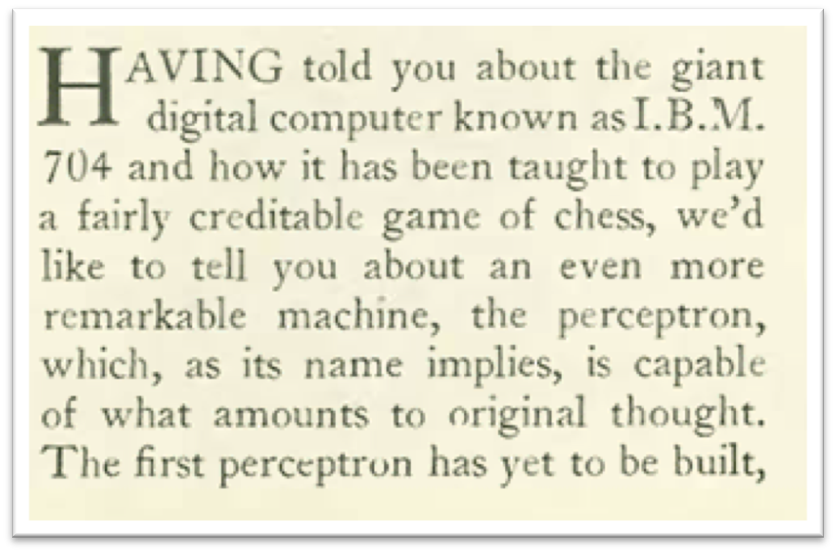
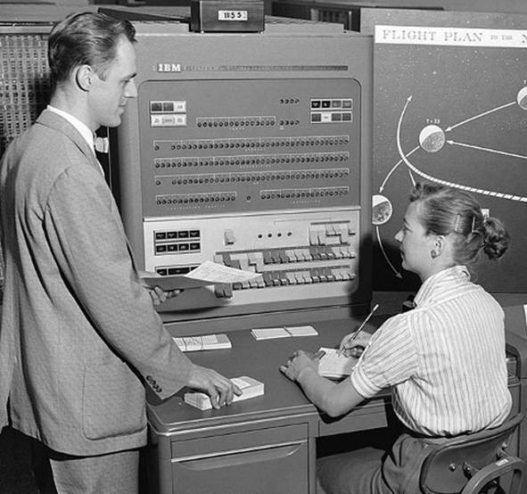
The hype
The New Yorker, December 6, 1958 P. 44
The New York Times, July 8 1958
The IBM 704 computer
8

Slide 9
The Perceptron algorithm
Rosenblatt 1958
The goal is to find a separating hyperplane
For separable data, guaranteed to find one
An online algorithm
Processes one example at a time
Several variants exist (will discuss briefly at towards the end)

Slide 10
The Perceptron algorithm
Input: A sequence of training examples (x₁, y₁), (x₂, y₂),! where all x_{i} ∈ ℜ^{n}, y_{i} ∈ {-1,1}
Initialize w₀ = 0 ∈ ℜ^{n}
For each training example (x_{i}, y_{i}):
Predict y’ = sgn(w_{t}^{T}x_{i})
If y_{i} ≠ y’:
Update w_{t+1} ←w_{t} + r (y_{i} x_{i})
Return final weight vector

Slide 11
The Perceptron algorithm
Input: A sequence of training examples (x₁, y₁), (x₂, y₂),! where all x_{i} ∈ ℜ^{n}, y_{i} ∈ {-1,1}
Remember: Prediction = sgn(w^{T}x)
There is typically a bias term also (w^{T}x + b), but the bias may be treated as a constant feature and folded into w
Initialize w₀ = 0 ∈ ℜ^{n}
For each training example (x_{i}, y_{i}):
– Predict y’ = sgn(w ^{T}x )
t i
If y_{i} ≠ y’:
Update w
←w_{t} + r (y_{i} x_{i})
t+1
Return final weight vector

Slide 12
The Perceptron algorithm
Input: A sequence of training examples (x₁, y₁), (x₂, y₂),! where all x_{i} ∈ ℜ^{n}, y_{i} ∈ {-1,1}
Remember: Prediction = sgn(w^{T}x)
There is typically a bias term also (w^{T}x + b), but the bias may be treated as a constant feature and folded into w
Initialize w₀ = 0 ∈ ℜ^{n}
For each training example (x , y ):
i i
– Predict y’ = sgn(w ^{T}x )
t i
If y_{i} ≠ y’:
Update w
←w_{t} + r (y_{i} x_{i})
t+1
Return final weight vector
Footnote: For some algorithms it is mathematically easier to represent False as -1, and at other times, as 0. For the Perceptron algorithm, treat -1 as false and +1 as true.
12

Slide 13
The Perceptron algorithm
Input: A sequence of training examples (x₁, y₁), (x₂, y₂),! where all x_{i} ∈ ℜ^{n}, y_{i} ∈ {-1,1}
Mistake on positive: w_{t+1} ← w_{t} + r x_{i}
Mistake on negative: w_{t+1} ← w_{t} - r x_{i}
Initialize w₀ = 0 ∈ ℜ^{n}
For each training example (x_{i}, y_{i}):
Predict y’ = sgn(w_{t}^{T}x_{i})
If y_{i} ≠ y’:
Update w_{t+1} ←w_{t} + r (y_{i} x_{i})
Return final weight vector

Slide 14
The Perceptron algorithm
Input: A sequence of training examples (x₁, y₁), (x₂, y₂),! where all x_{i} ∈ ℜ^{n}, y_{i} ∈ {-1,1}
Mistake on positive: w_{t+1} ← w_{t} + r x_{i}
Mistake on negative: w_{t+1} ← w_{t} - r x_{i}
Initialize w₀ = 0 ∈ ℜ^{n}
For each training example (x_{i}, y_{i}):
r is the learning rate, a small positive number less than 1
– Predict y’ = sgn(w ^{T}x )
t i
If y_{i} ≠ y’:
Update w_{t+1} ←w_{t} + r (y_{i} x_{i})
Return final weight vector

Slide 15
The Perceptron algorithm
Input: A sequence of training examples (x₁, y₁), (x₂, y₂),! where all x_{i} ∈ ℜ^{n}, y_{i} ∈ {-1,1}
Mistake on positive: w_{t+1} ← w_{t} + r x_{i}
Mistake on negative: w_{t+1} ← w_{t} - r x_{i}
Initialize w₀ = 0 ∈ ℜ^{n}
For each training example (x_{i}, y_{i}):
r is the learning rate, a small positive number less than 1
– Predict y’ = sgn(w ^{T}x )
t i
If y_{i} ≠ y’:
Update w_{t+1} ←w_{t} + r (y_{i} x_{i})
Return final weight vector
Update only on error. A mistake- driven algorithm

Slide 16
The Perceptron algorithm
Input: A sequence of training examples (x₁, y₁), (x₂, y₂),! where all x_{i} ∈ ℜ^{n}, y_{i} ∈ {-1,1}
Mistake on positive: w_{t+1} ← w_{t} + r x_{i}
Mistake on negative: w_{t+1} ← w_{t} - r x_{i}
Initialize w₀ = 0 ∈ ℜ^{n}
For each training example (x_{i}, y_{i}):
r is the learning rate, a small positive number less than 1
– Predict y’ = sgn(w ^{T}x )
t i
If y_{i} ≠ y’:
Update w_{t+1} ←w_{t} + r (y_{i} x_{i})
Return final weight vector
Update only on error. A mistake- driven algorithm
This is the simplest version. We will see more robust versions at the end

Slide 17
The Perceptron algorithm
Input: A sequence of training examples (x₁, y₁), (x₂, y₂),! where all x_{i} ∈ ℜ^{n}, y_{i} ∈ {-1,1}
Mistake on positive: w_{t+1} ← w_{t} + r x_{i}
Mistake on negative: w_{t+1} ← w_{t} - r x_{i}
Initialize w₀ = 0 ∈ ℜ^{n}
For each training example (x_{i}, y_{i}):
r is the learning rate, a small positive number less than 1
– Predict y’ = sgn(w ^{T}x )
t i
If y_{i} ≠ y’:
Update w_{t+1} ←w_{t} + r (y_{i} x_{i})
Return final weight vector
Update only on error. A mistake- driven algorithm
This is the simplest version. We will see more robust versions at the end
Mistake can be written as y_{i}w_{t} x_{i} ≤ 0
T

Slide 18
Intuition behind the update
Mistake on positive: w_{t+1} ← w_{t} + r x_{i}
Mistake on negative: w_{t+1} ← w_{t} - r x_{i}
Suppose we have made a mistake on a positive example That is, y = +1 and w_{t}^{T} x <0
Call the new weight vector w_{t+1} = w_{t} + x (say r = 1)
The new dot product will be w_{t+1} x = (w_{t} + x) T x = w_{t} Tx + x x > w_{t} x
^{T}
For a positive example, the Perceptron update will increase the score assigned to the same input
Similar reasoning for negative examples

Slide 19


Mistake on positive: w_{t+1} ← w_{t} + r x_{i}
Mistake on negative: w_{t+1} ← w_{t} - r x_{i}
Geometry of the perceptron update
Predict
^{w}old

Slide 20

Mistake on positive: w_{t+1} ← w_{t} + r x_{i}
Mistake on negative: w_{t+1} ← w_{t} - r x_{i}
Geometry of the perceptron update
Predict
^{w}old
(x, +1)

Slide 21
Geometry of the perceptron update
Mistake on positive: w_{t+1} ← w_{t} + r x_{i}
Mistake on negative: w_{t+1} ← w_{t} - r x_{i}
Predict
^{w}old
(x, +1)
For a mistake on a positive example

Slide 22



Geometry of the perceptron update
Mistake on positive: w_{t+1} ← w_{t} + r x_{i}
Mistake on negative: w_{t+1} ← w_{t} - r x_{i}
Predict
Update
w ← w + x
^{w}old
(x, +1)
(x, +1)
For a mistake on a positive example

Slide 23

Geometry of the perceptron update
Mistake on positive: w_{t+1} ← w_{t} + r x_{i}
Mistake on negative: w_{t+1} ← w_{t} - r x_{i}
Predict
Update
w ← w + x
w
old
x
(x, +1)
(x, +1)
For a mistake on a positive example

Slide 24

Geometry of the perceptron update
Mistake on positive: w_{t+1} ← w_{t} + r x_{i}
Mistake on negative: w_{t+1} ← w_{t} - r x_{i}
Predict
Update
w ← w + x
w
old
x
(x, +1)
(x, +1)
For a mistake on a positive example

Slide 25



Geometry of the perceptron update
Mistake on positive: w_{t+1} ← w_{t} + r x_{i}
Mistake on negative: w_{t+1} ← w_{t} - r x_{i}
Predict
Update
After
w ← w + x
w
old
x
^{w}new
(x, +1)
(x, +1)
(x, +1)
For a mistake on a positive example

Slide 26

Geometry of the perceptron update
Predict
^{w}old

Slide 27
Geometry of the perceptron update
Predict
(x, -1) _{wold}
For a mistake on a negative example

Slide 28

Geometry of the perceptron update
Predict
Update
w ← w - x
(x, -1)
(x, -1)
- x
^{w}old
For a mistake on a negative example

Slide 29

Geometry of the perceptron update
Predict
Update
w ← w - x
(x, -1)
(x, -1)
- x
^{w}old
For a mistake on a negative example

Slide 30

Geometry of the perceptron update
Predict
Update
w ← w - x
(x, -1)
(x, -1)
- x
^{w}old
For a mistake on a negative example

Slide 31

Geometry of the perceptron update
Predict
Update
After
w ← w - x
(x, -1)
- x
^{w}new
(x, -1)
(x, -1)
^{w}old
For a mistake on a negative example

Slide 32
Perceptron Learnability
Obviously Perceptron cannot learn what it cannot represent
Only linearly separable functions
Minsky and Papert (1969) wrote an influential book demonstrating Perceptron’s representational limitations
Parity functions can’t be learned (XOR)
But we already know that XOR is not linearly separable
Feature transformation trick

Slide 33
Convergence
Convergence theorem
– If there exist a set of weights that are consistent with the data (i.e. the data is linearly separable), the perceptron algorithm will converge.

Slide 34
Convergence
Convergence theorem
If there exist a set of weights that are consistent with the data (i.e. the data is linearly separable), the perceptron algorithm will converge.
Cycling theorem
If the training data is not linearly separable, then the learning algorithm will eventually repeat the same set of weights and enter an infinite loop

Slide 35
Summary: Perceptron
Online learning algorithm, very widely used, easy to implement
Additive updates to weights
Geometric interpretation
You should be able to implement the Perceptron algorithm
Follow the tutorial : https://www.tutorialspoint.com/tensorflow/tensorflow_single_layer_perceptron.htm

